Slide 1
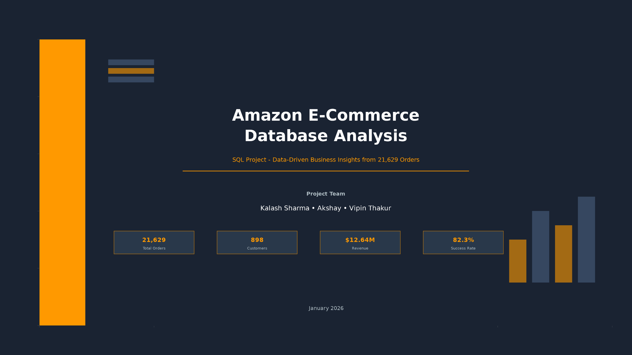

Slide 2


Slide 3
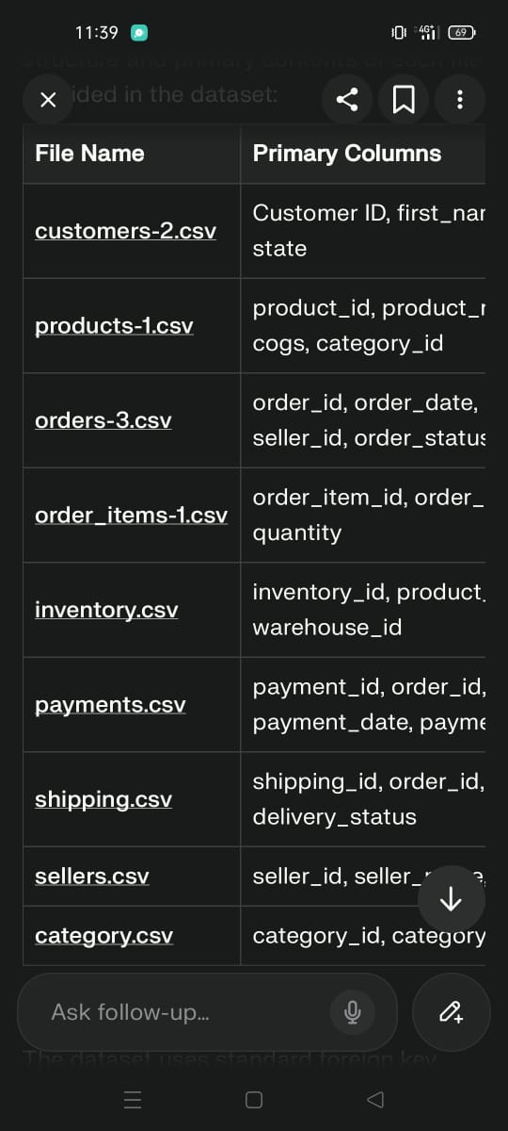
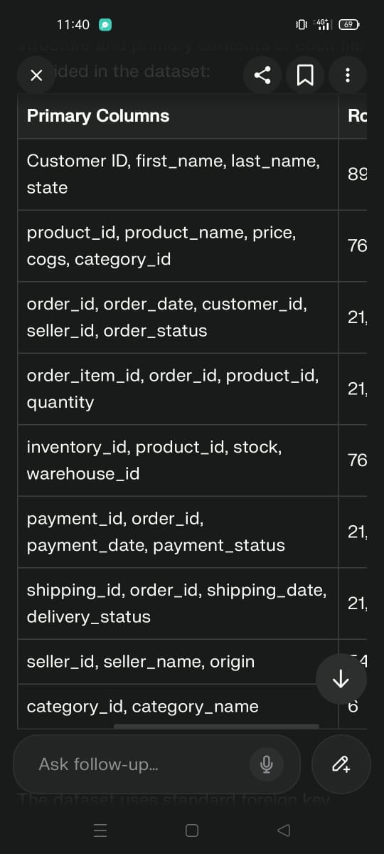
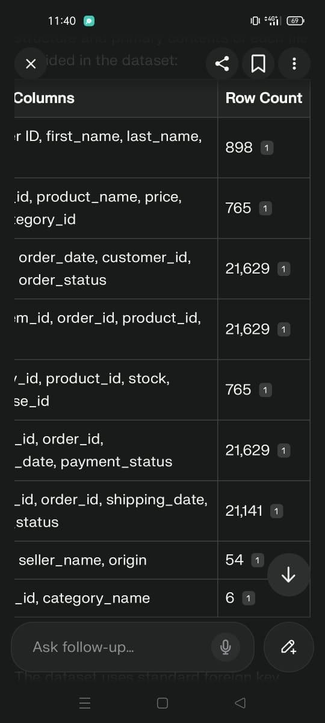
Data View:

Slide 4
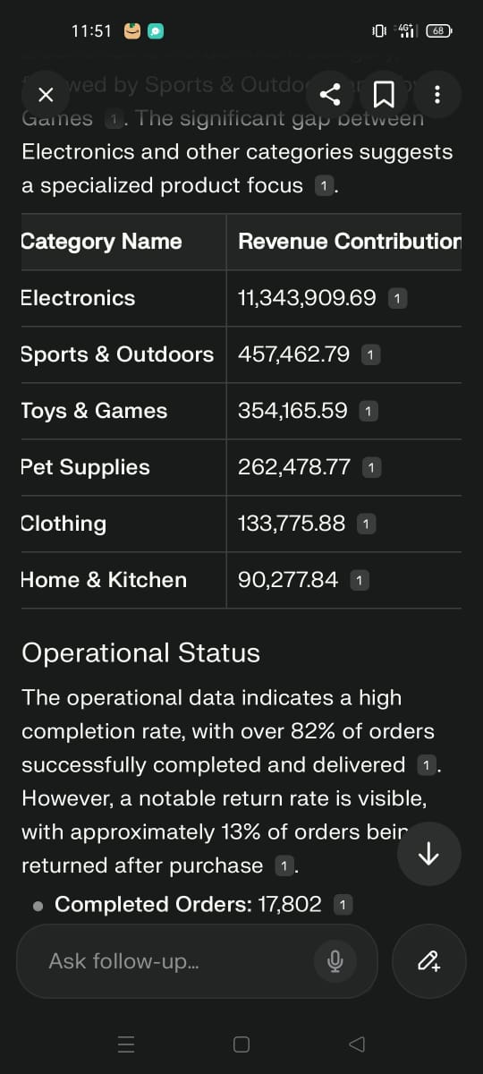
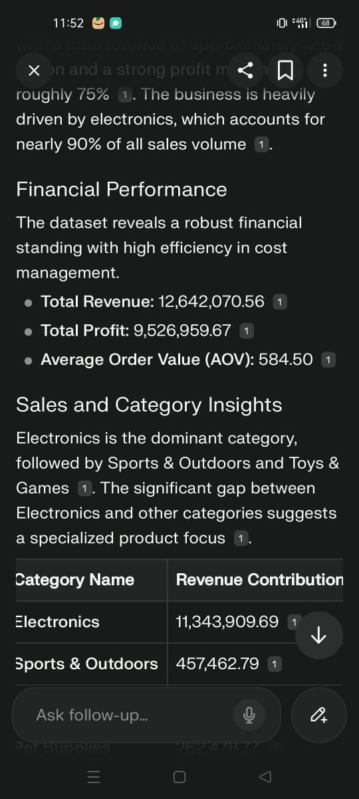

Slide 5
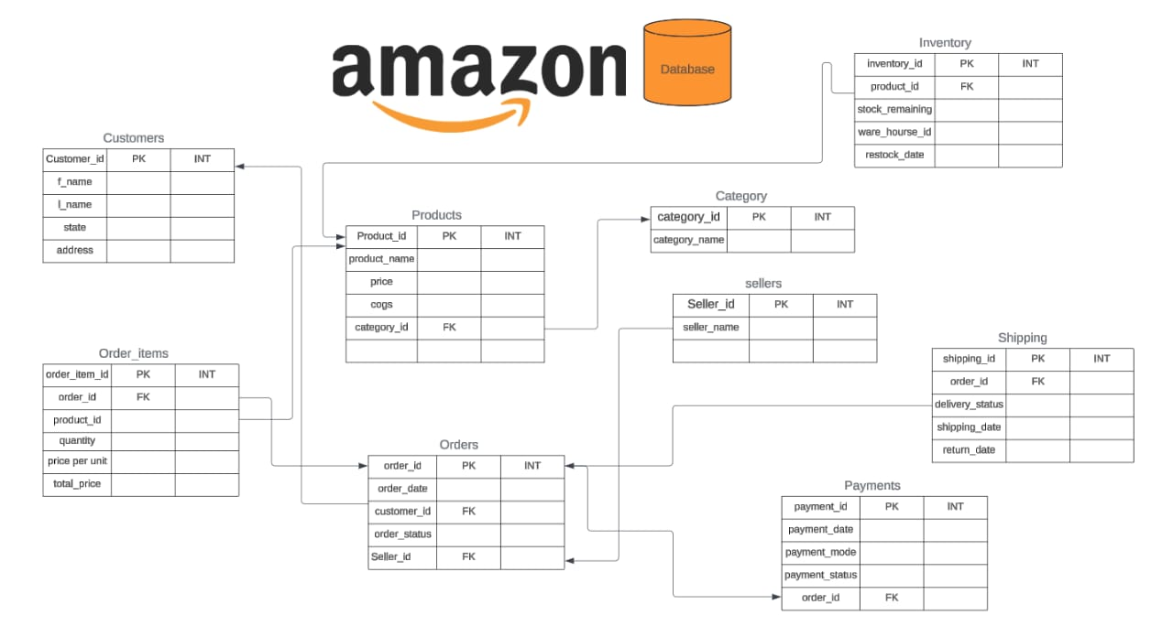

Slide 6
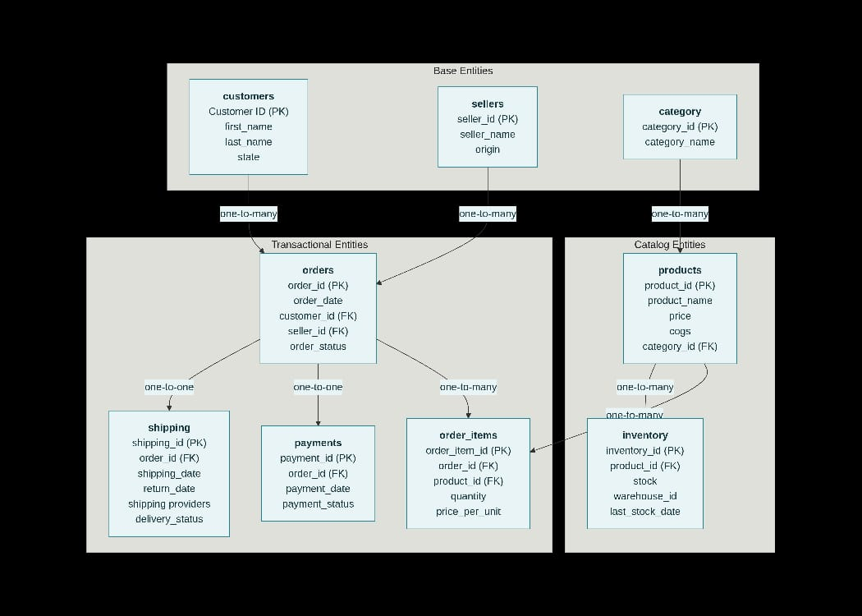

Slide 7
Project Overview
Goal: Analyze Amazon‑style e‑commerce data to understand revenue drivers, customer behavior, operations efficiency, and business risks.
Scope: 9 tables (orders, customers, products, categories, order_items, payments, shipping, inventory, sellers) with 21k+ orders and 700+ products, answering 10 mandatory business questions using SQL plus additional insights and charts.

Slide 8
Key headline metrics
total revenue ≈ $12.6M, 21,629 orders, 898 customers, 765 products, AOV ≈ $584, payment success ≈ 84.6%, return rate ≈ 13.1%, and 51 low‑stock items.

Slide 9
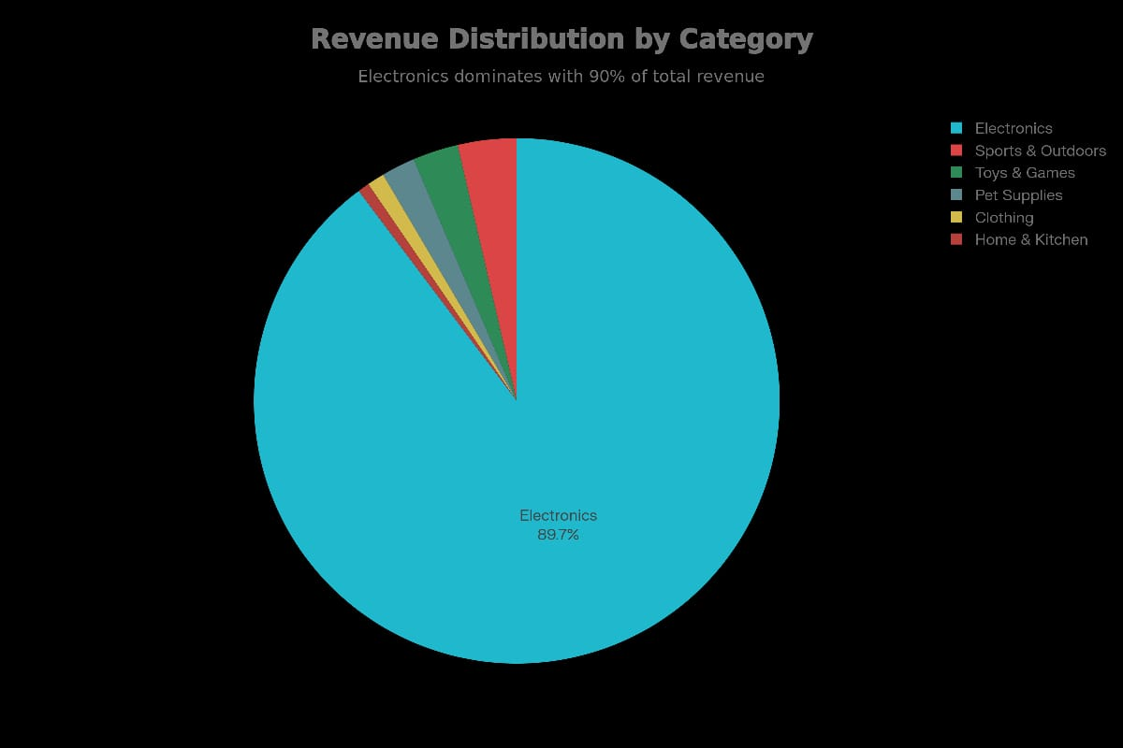

Slide 10

ANALYTICS LAYER
10 core SQL questions

Slide 11
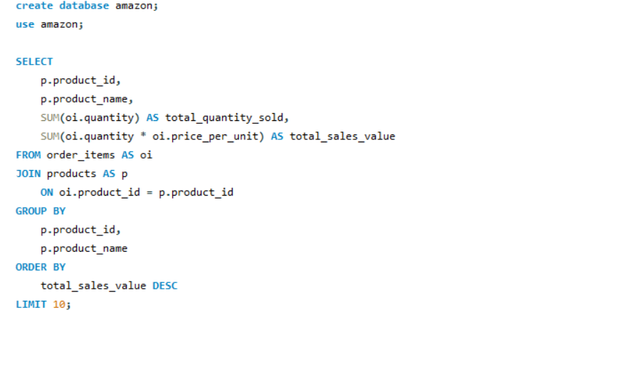
Q.1 Query the top 10 products by total sales value, including product name, total quantity sold, and total sales value.

Slide 12
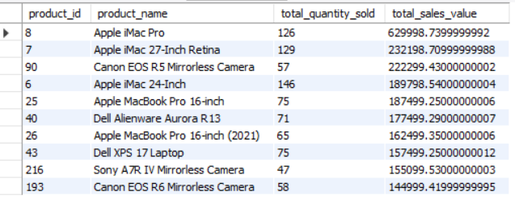
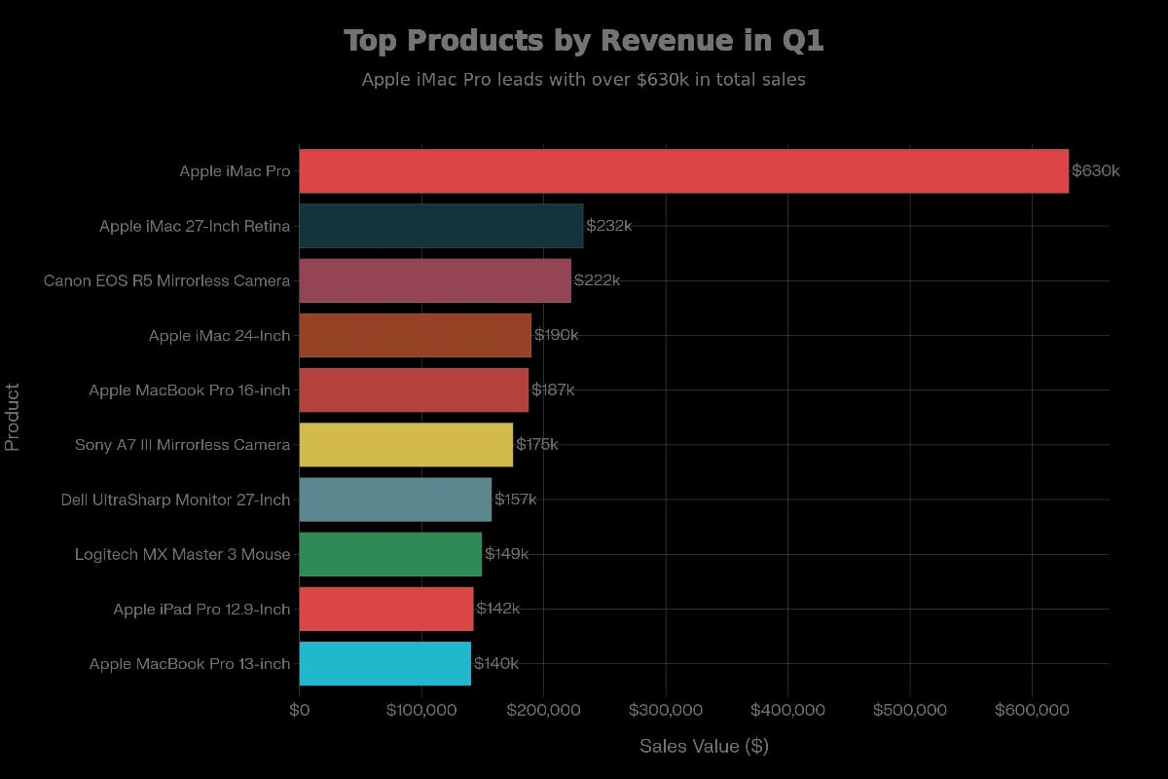

Slide 13
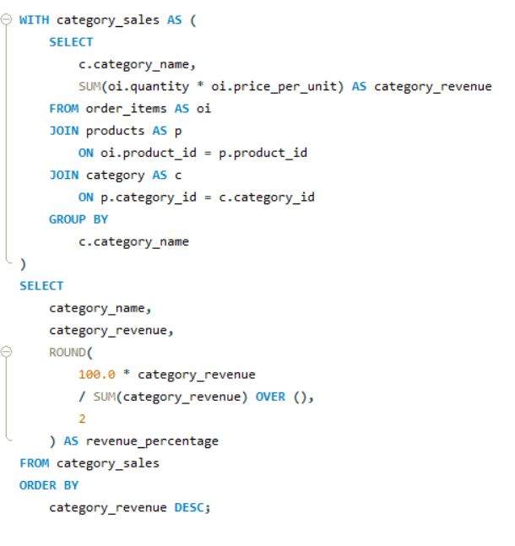
Q.2 Calculate total revenue generated by each product category and include the percentage contribution of each category to total revenue.

Slide 14
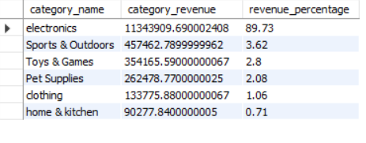
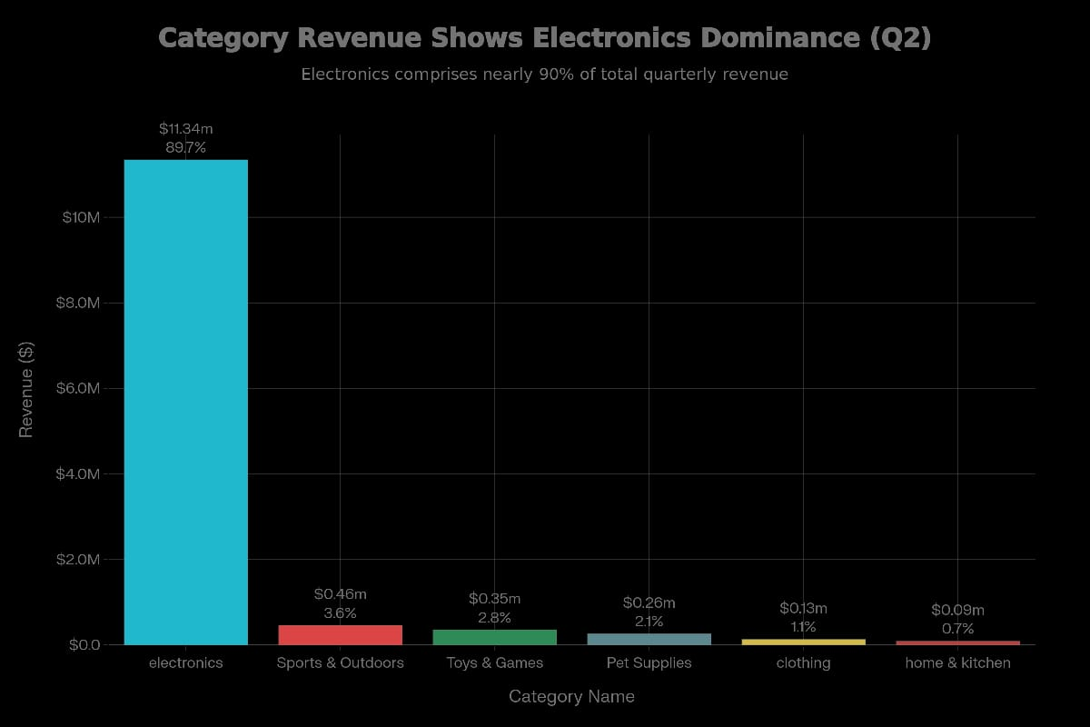

Slide 15
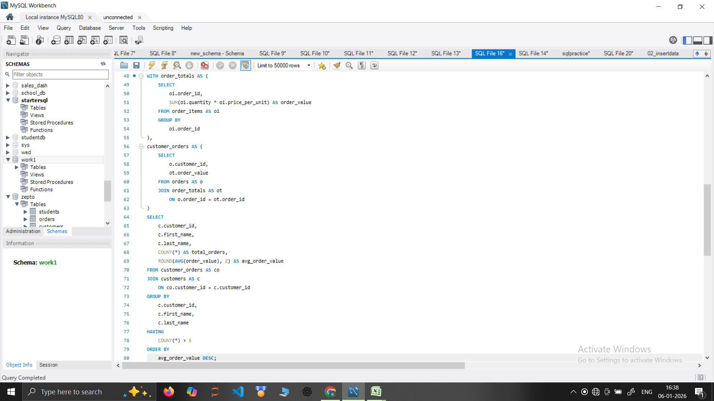
Q.3 Compute the average order value (AOV) for each customer and include only customers with more than 5 orders.

Slide 16
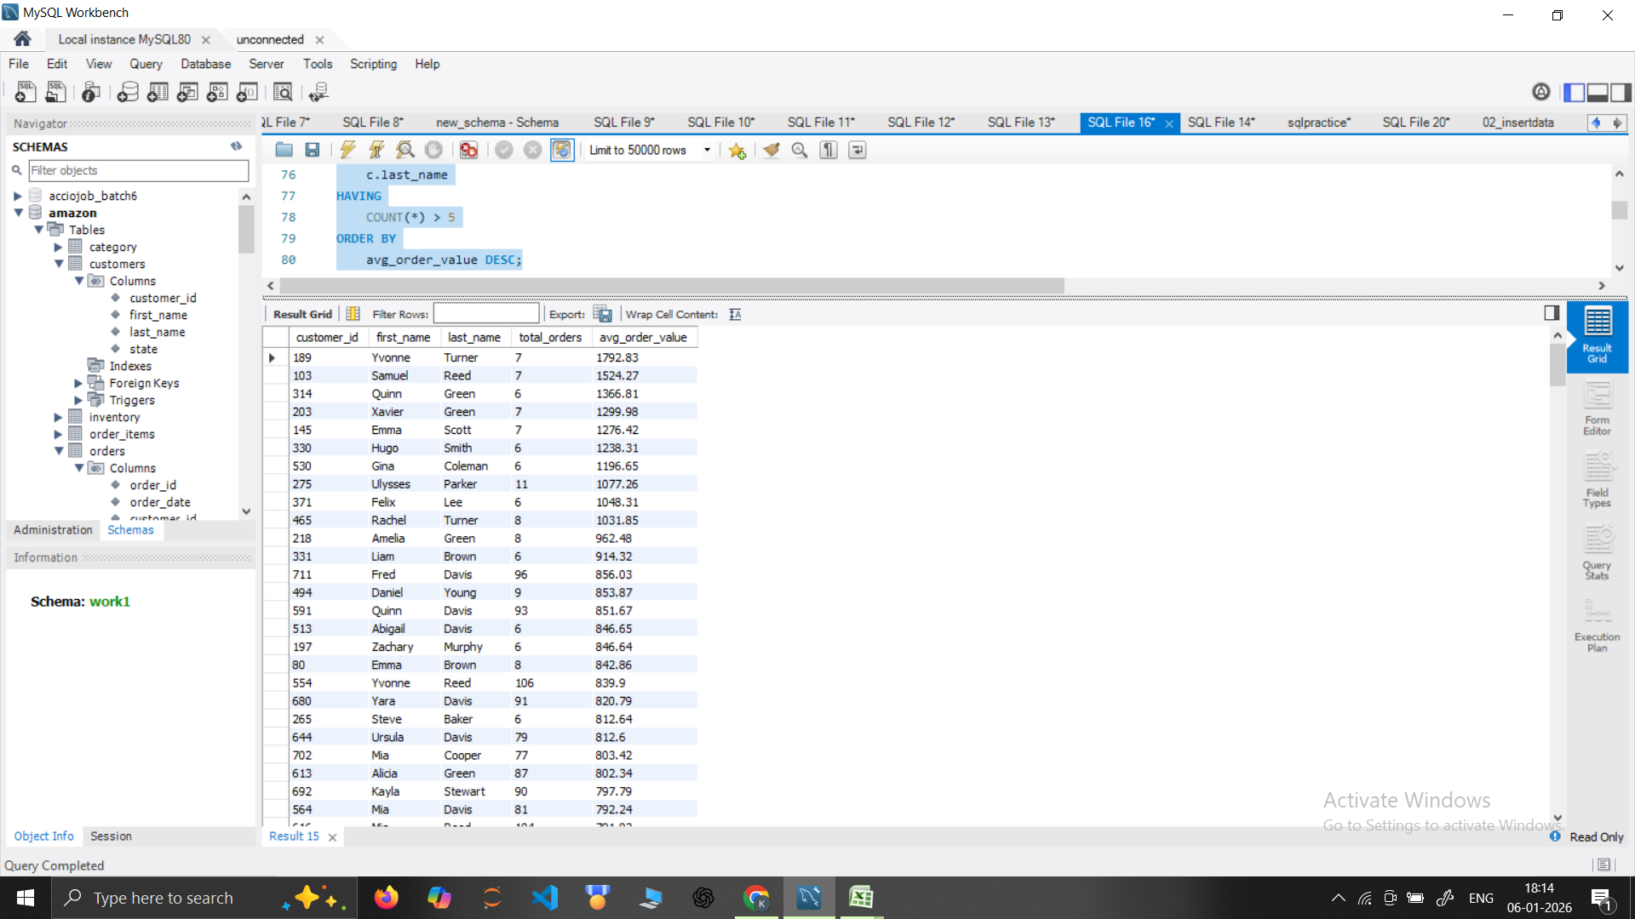
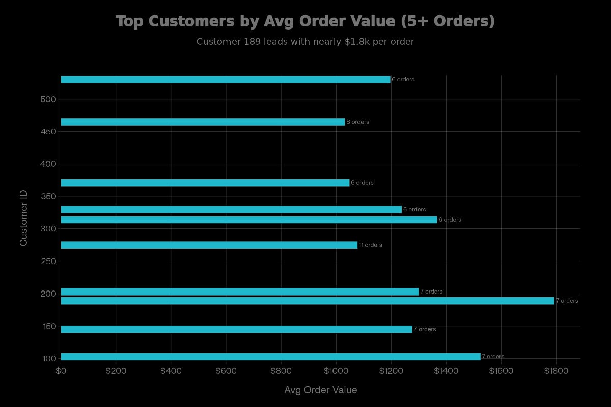

Slide 17
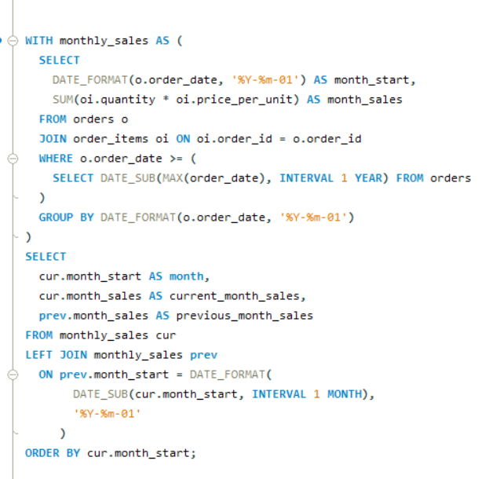
Q.4 Query monthly total sales over the past year and display the current month’s sales along with the previous month’s sales.

Slide 18
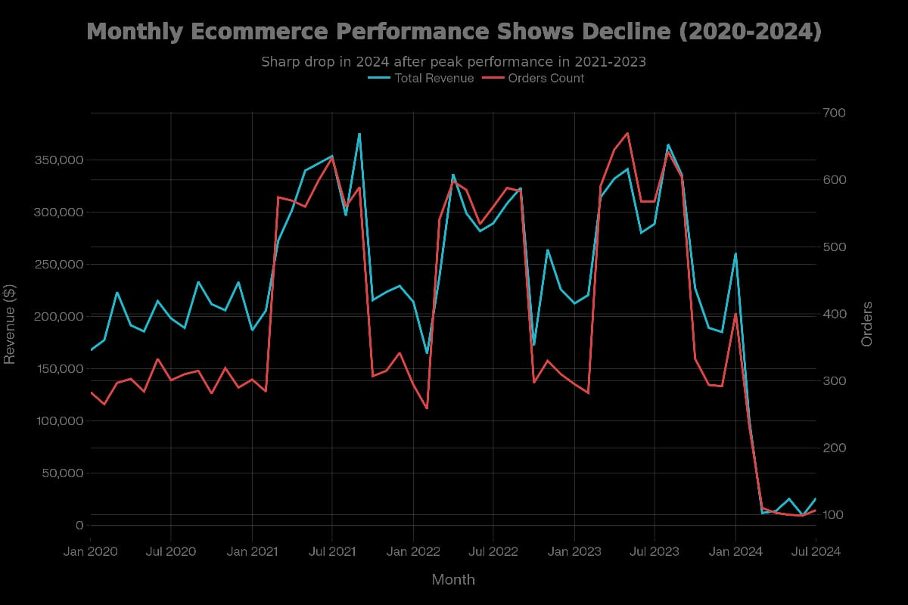
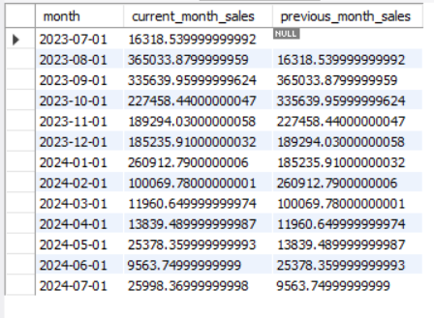

Slide 19
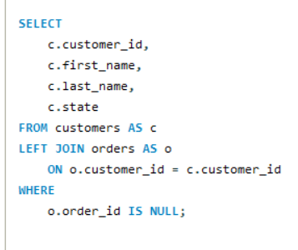
Q.5 Find customers who have registered but never placed an order, listing customer details and the time since their registration.

Slide 20
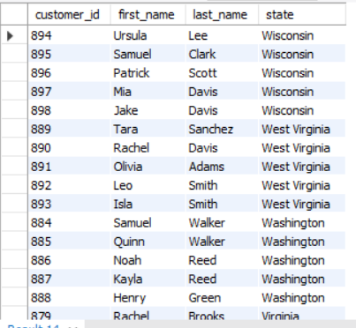

Slide 21
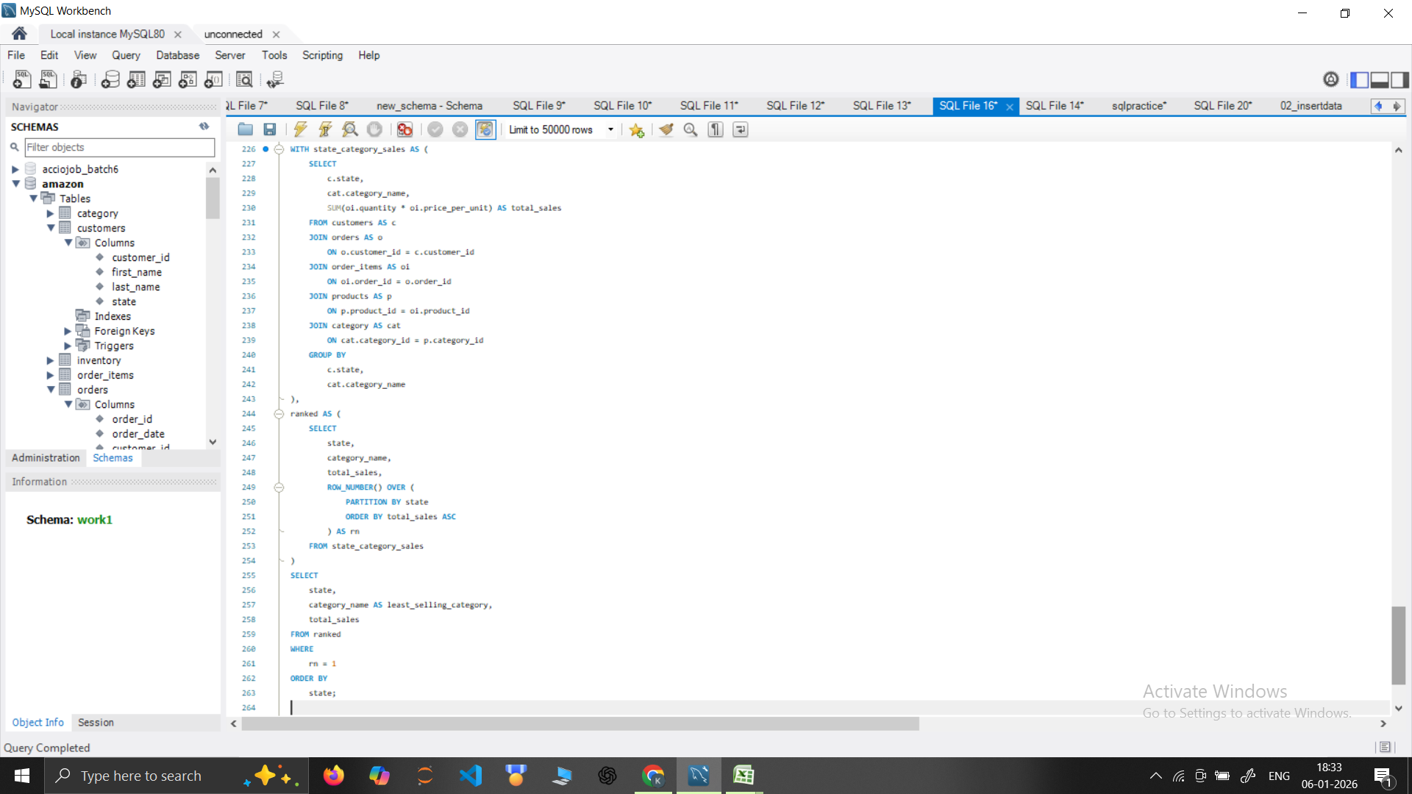
Q.6 Identify the least-selling product category for each state and include the total sales for that category within each state.

Slide 22
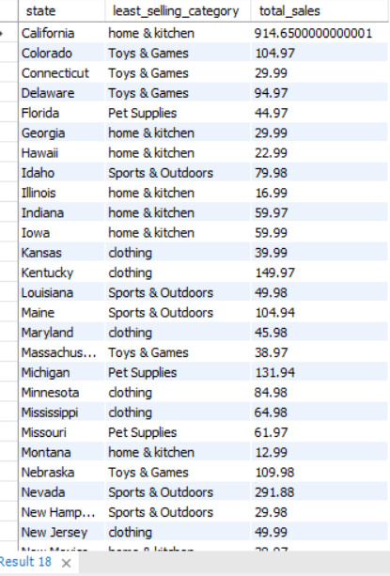

Slide 23
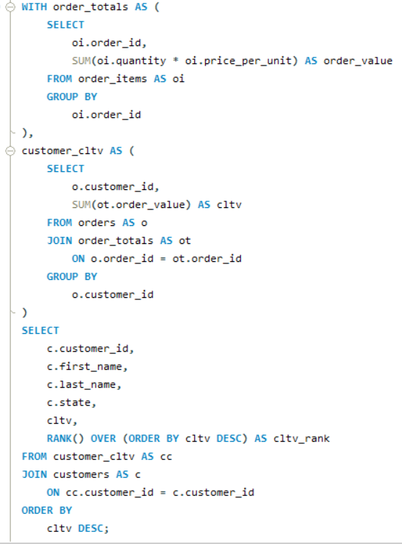
Q.7 Calculate the customer lifetime value (CLTV) for each customer and rank customers based on their CLTV.

Slide 24
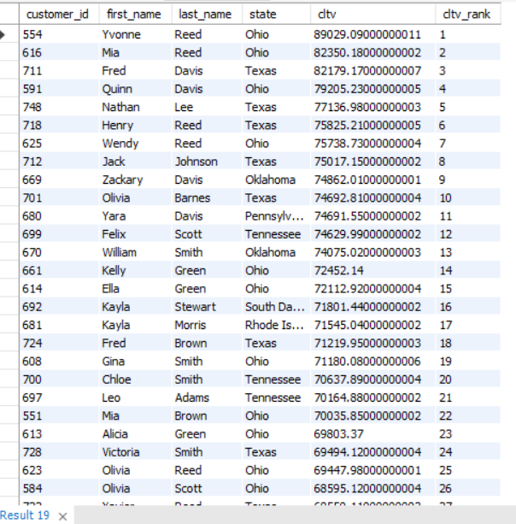

Slide 25
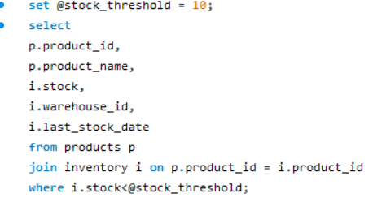
Q.8 Query products with stock levels below a certain threshold (e.g., less than 10 units) and include the last restock date and warehouse information.

Slide 26
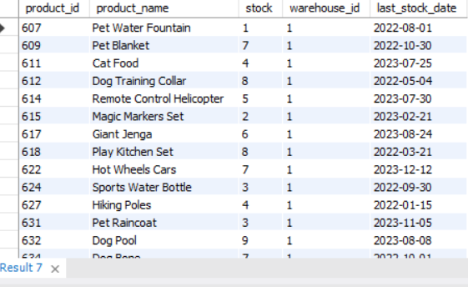

Slide 27
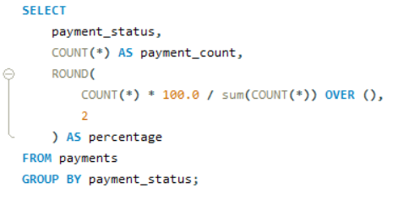
Q.9 Calculate the percentage of successful payments across all orders and include a breakdown by payment status such as failed and pending.

Slide 28
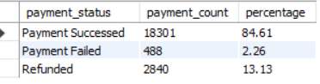
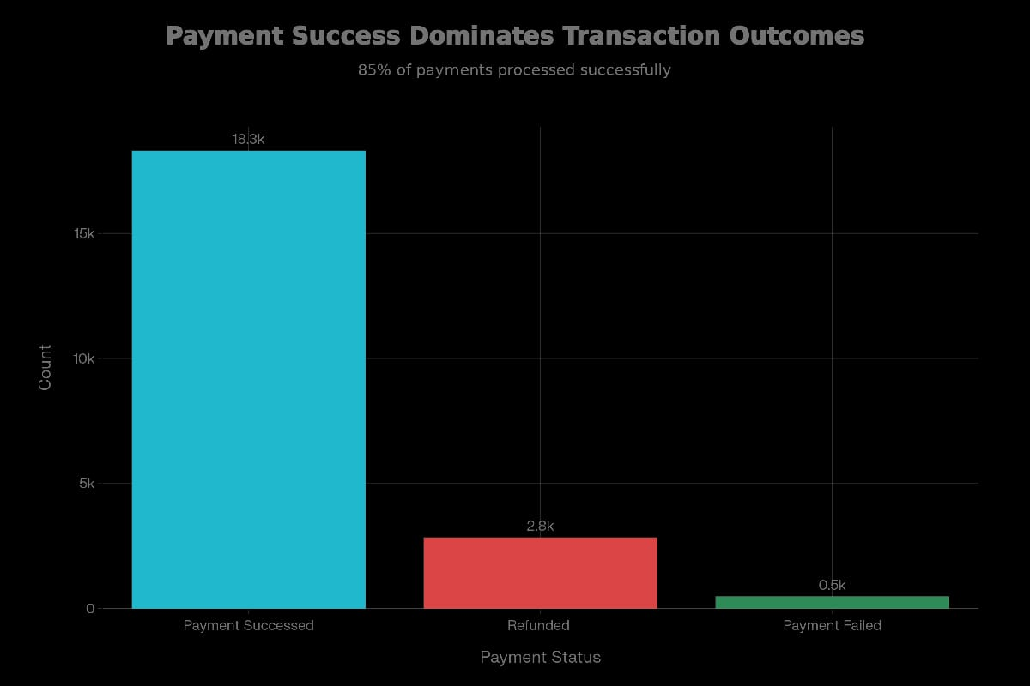

Slide 29
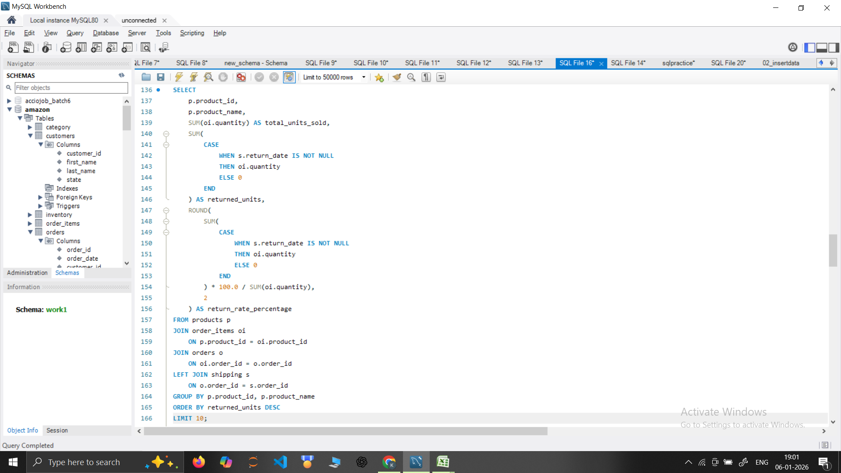
Q.10 Query the top 10 products by the number of returns and display the return rate as a percentage of total units sold for each product.

Slide 30
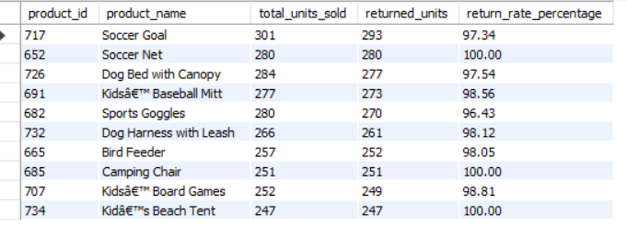
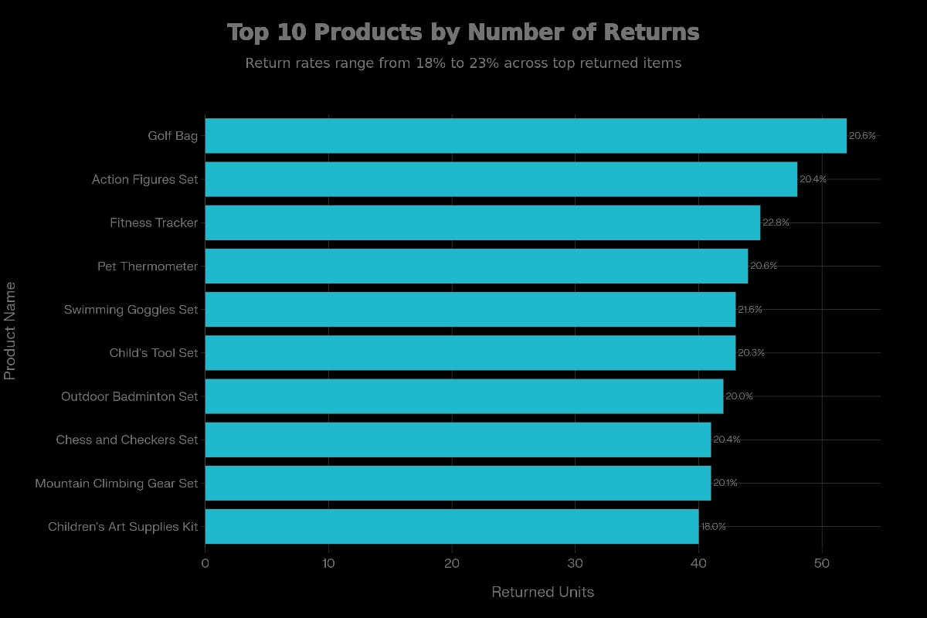

Slide 31
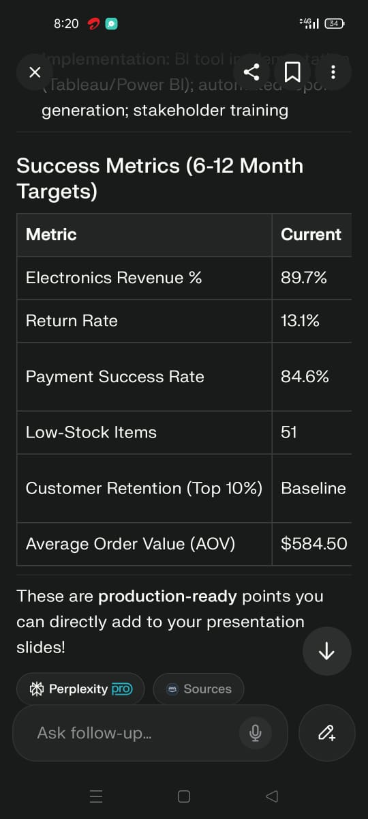
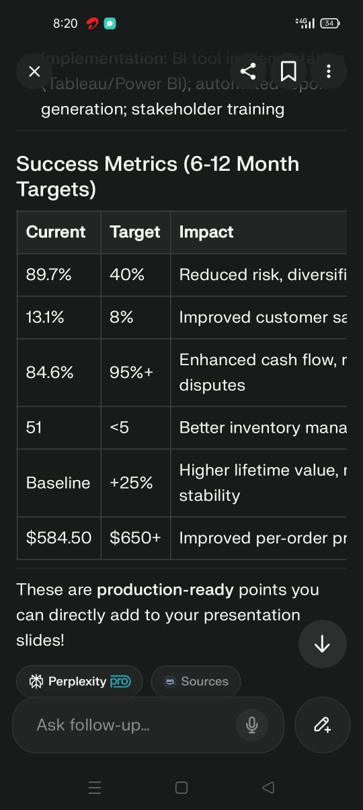
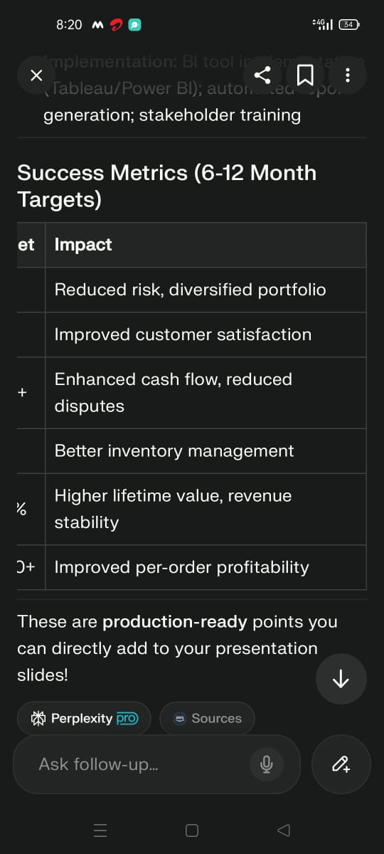
Success Metrics (6-12 Month Target):

Slide 32
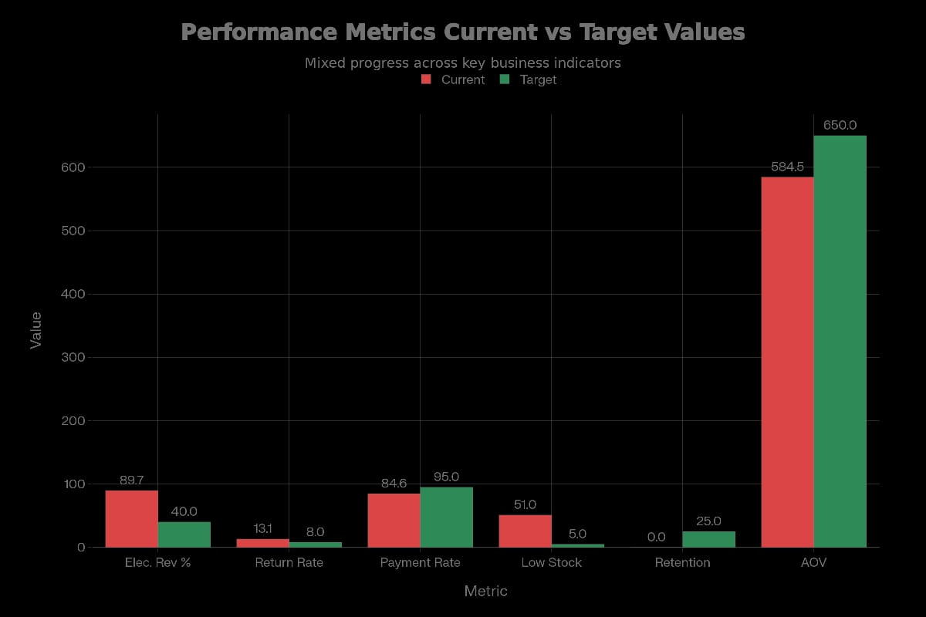

Slide 33
CONCLUSION
Successfully analyzed 21,629 orders generating $12.6M revenue across 9 integrated database tables. Key insights:
-89.7% revenue from electronics → concentration risk requiring diversification.
-13.1% return rate → quality issues in products like Golf Bag, Action Figures.
-51 low-stock items → inventory management gaps.
-84.6% payment success → strong transaction infrastructure.
-High CLTV disparity → opportunity to focus on top 10% high-value customers

Slide 34
RECOMMENDATIONS
-Diversify Revenue - Grow non-electronics from 10% to 60% of total revenue.
-Reduce Returns - Target 8% return rate through quality audits and supplier improvements.
-Automate Inventory - Implement auto-reorder triggers for stock below 10 units.
-Customer Loyalty - VIP program for top 10% CLTV customers.
-Payment Optimization - Investigate 15.4% failed/refunded transactions

Slide 35
THANK YOU.

